Slide 1
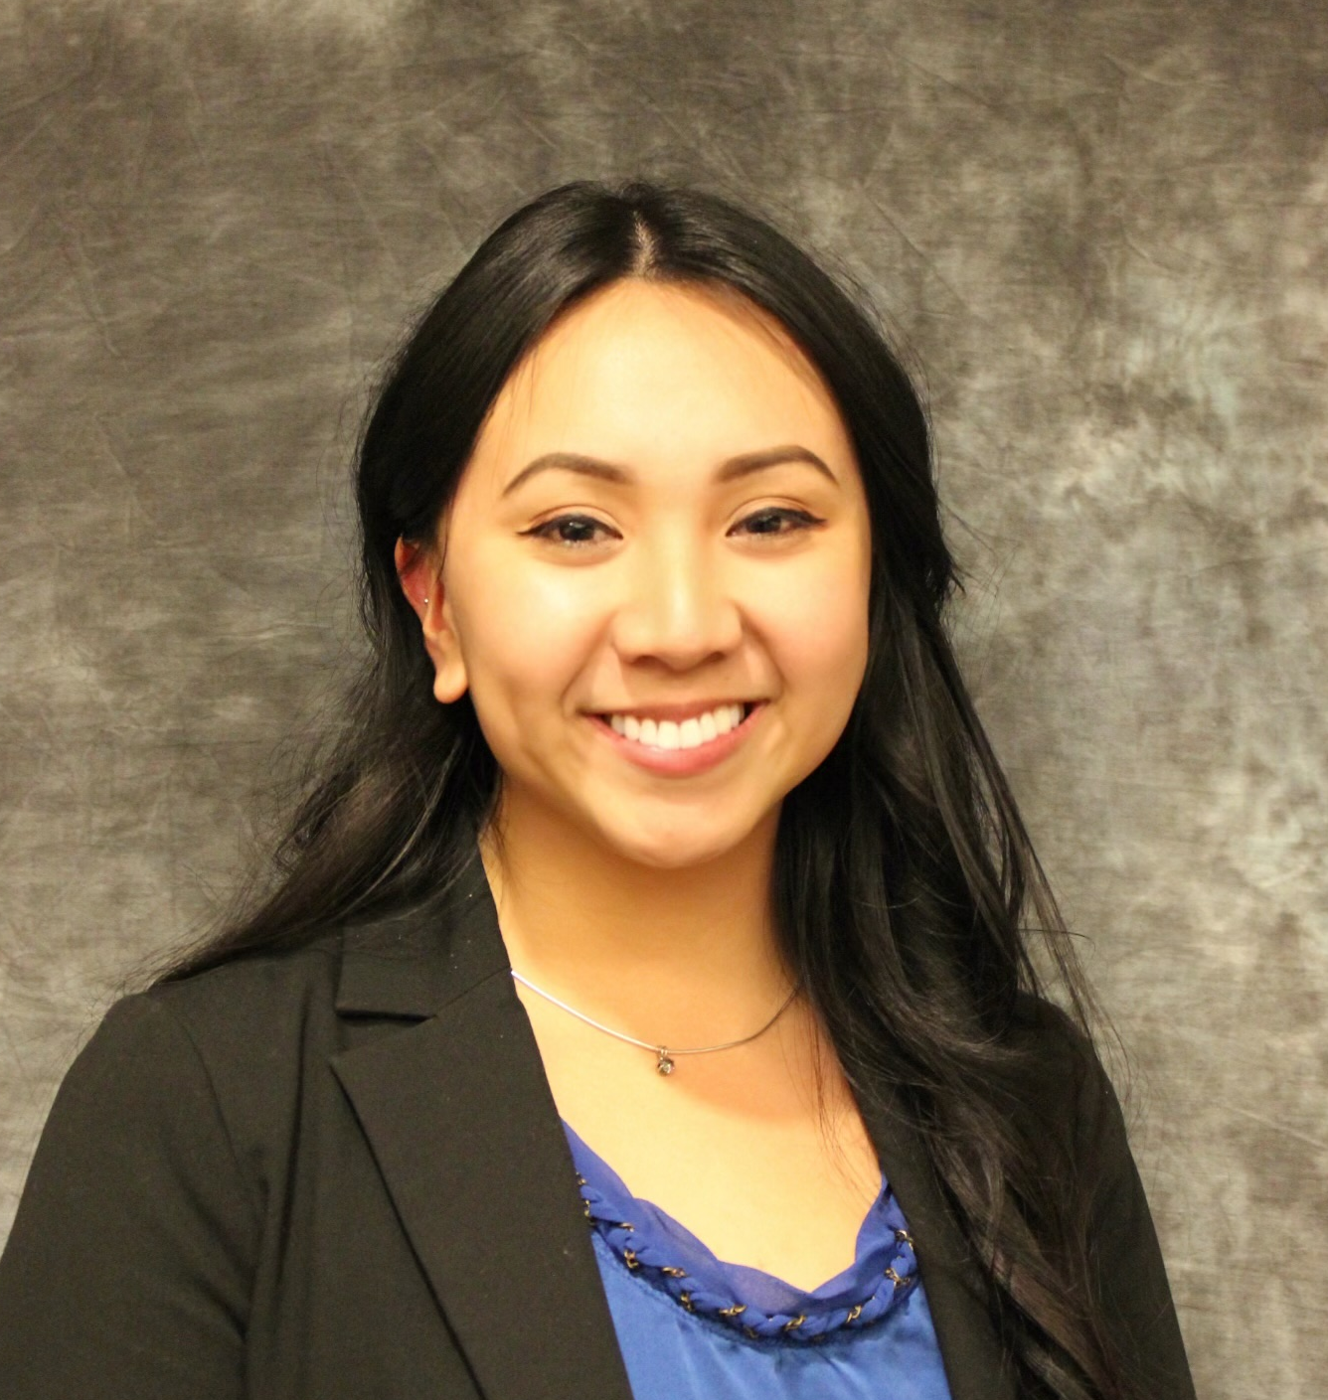
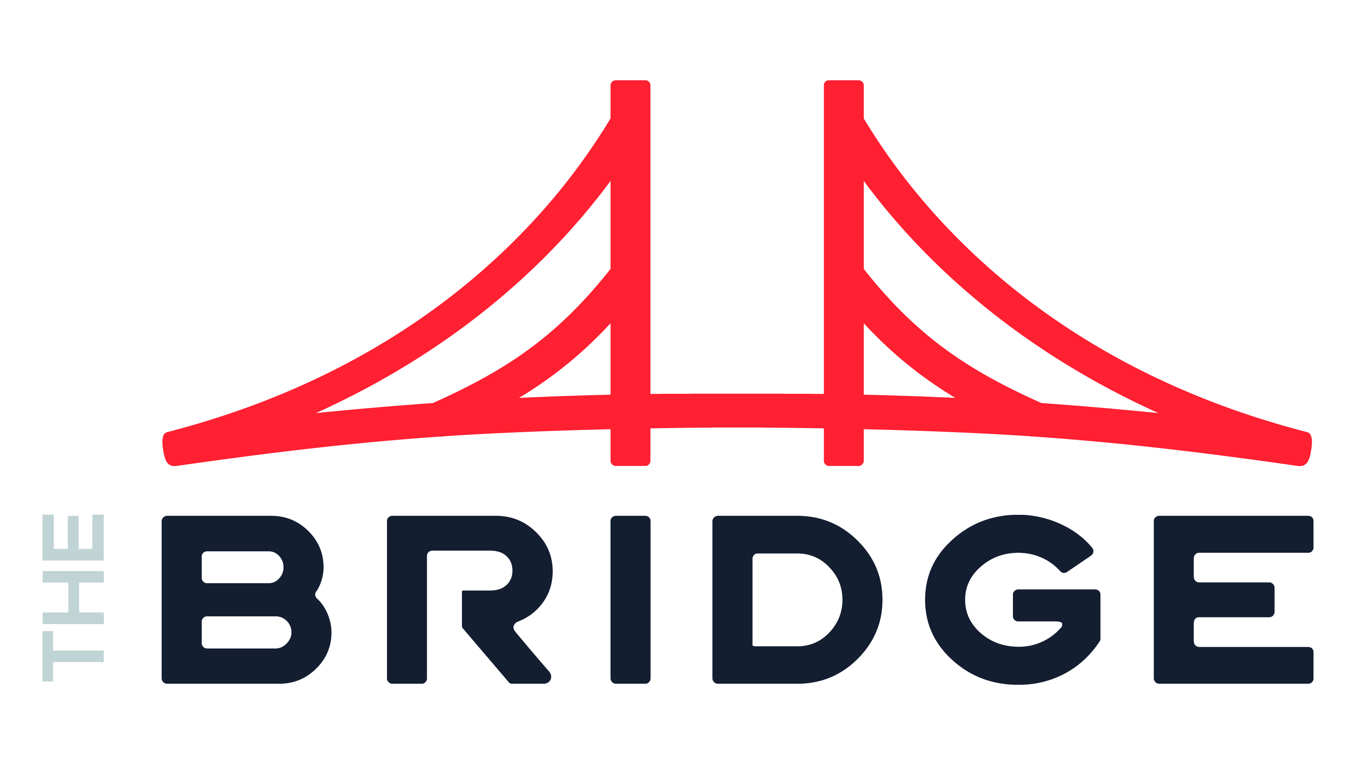
EMILY YANG MANAGER
INDUSTRIES
Industry Experience
Food Distribution, Education,
Healthcare, Entertainment,
Hospitality, Retail
Future Project Interests
Technology, Entertainment, Defense
EXPERIENCE
Program Manager | Enjoy Technology
Implemented ServiceNow with implementation partners and technical teams using Agile methodology and Kanban boards. Scope included asset management, change management, IT incident management, and request management, as well as the integration of Oracle HCM and Okta.
Collaborated with 30 business and technical stakeholders across the company including the C-suite to assess and implement IT controls to follow ISO 27001 compliance and to prepare for SOX audits, including user access reviews, policy revisions and adherence, and identity access management.
Managed field directory and location hierarchy implementation in Oracle, which included data cleanup, user training, and workflow edits. This allowed for organization-wide scalability via automatic updates.
Project Manager, Oracle HCM Cloud | Kaiser Permanente
Led the redesign of the change control process on a $600 million HCM program by collaborating with multiple cross-functional and technical teams. This included identifying opportunities that led to clearer business requirements, timely reporting and escalations of risks and issues, and training of more than 200 project team members, which resulted in 58% fewer open requests per week.
Managed the project plan, resource allocation, and communications plan for an auxiliary program support team by collaborating with project team leads to meet critical business and union requirements.
Partnered with the adoption team and product owners to build product awareness to more than 200,000 employees. Solutions included providing technological and program support to more than 25 business readiness workshops and conferences, capturing feedback that resolved over 300 risks and issues.
BACKGROUND
Functional Skills
Project Management, Program Management, Change Management, Stakeholder Management, Compliance, Process Improvement, Talent Acquisition, Event Planning
Qualifications
Project Management Professional
Education
University of California, Riverside
Master of Business Administration
University of California, Riverside
Bachelor of Science, Business Administration
BIO & CONTACT INFO
Email
Emily.Yang@thebridge.com
Mobile
(510) 725-2108
Location
Los Angeles, CA
Before joining The Bridge in October 2022, Emily worked as a program and project manager in retail technology and healthcare. She also has change management, talent acquisition, and event planning experience across various industries. Emily’s proactivity, critical thinking, and communication skills allow her to create quality deliverables, build strong teams and relationships, and implement long-lasting solutions.

